Slide 1

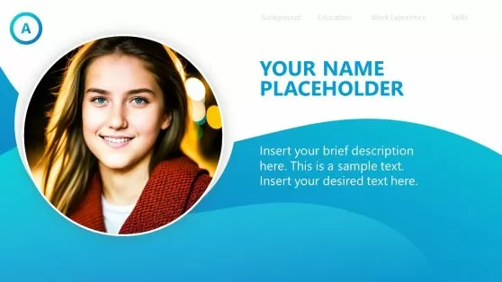
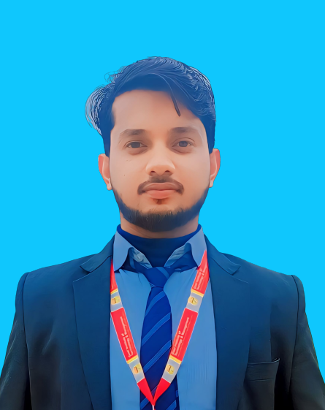
SELF INTRODUCTION
Self Introduction
Vishal bhagat
COURSE :- B.TECH IN COMPUTER SCIENCE AND ENGINEERING
COLLAGE :- Goel Institute of Management Technology, Lucknow

Slide 2
A COMPANY FOUNDED BY TECHNOCRATS FROM IIT KANPUR & IET LUCKNOW
Company Introduction
SOFTPRO INDIA
Computer Technologies (P) Limited
Bridging The Technology GAP

Slide 3
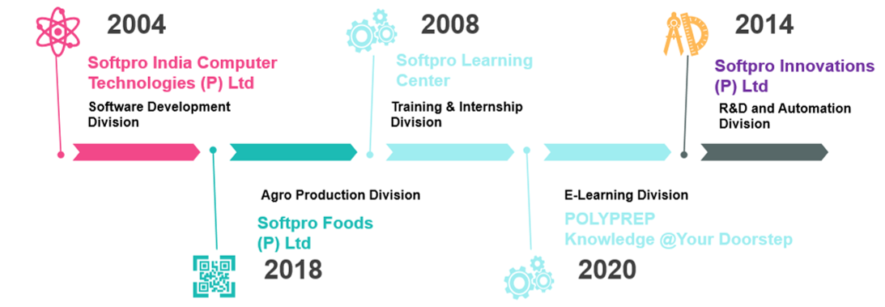
SOFTPRO infographic
http://www.trainingatsoftpro.com

Slide 4
ABOUT SOFTPRO
Softpro India Computer Technologies (P) Ltd is a complete Technology Services and Solutions provider to
the clients. It is an ISO 9001:2015 Certified Company, incorporated in the year 2004, by Technocrats from
IIT Kanpur and IET Lucknow. The Company is devoted to provide Software Solutions to patrons in verticals like Manufacturing, IT Services, Pharmaceutical and Education Sector. Softpro is an acclaimed member of UPDESCO which facilitates software development in government sectors in UP.
Softpro Learning Centre: This vertical is the training division of the company commenced in 2008 with a perception to bridge the Technology Gap prevalent between students and professionals. Softpro Learning Centre has embarked itself as one of the most propitious centres for learning across UP and nearby states.

Slide 5
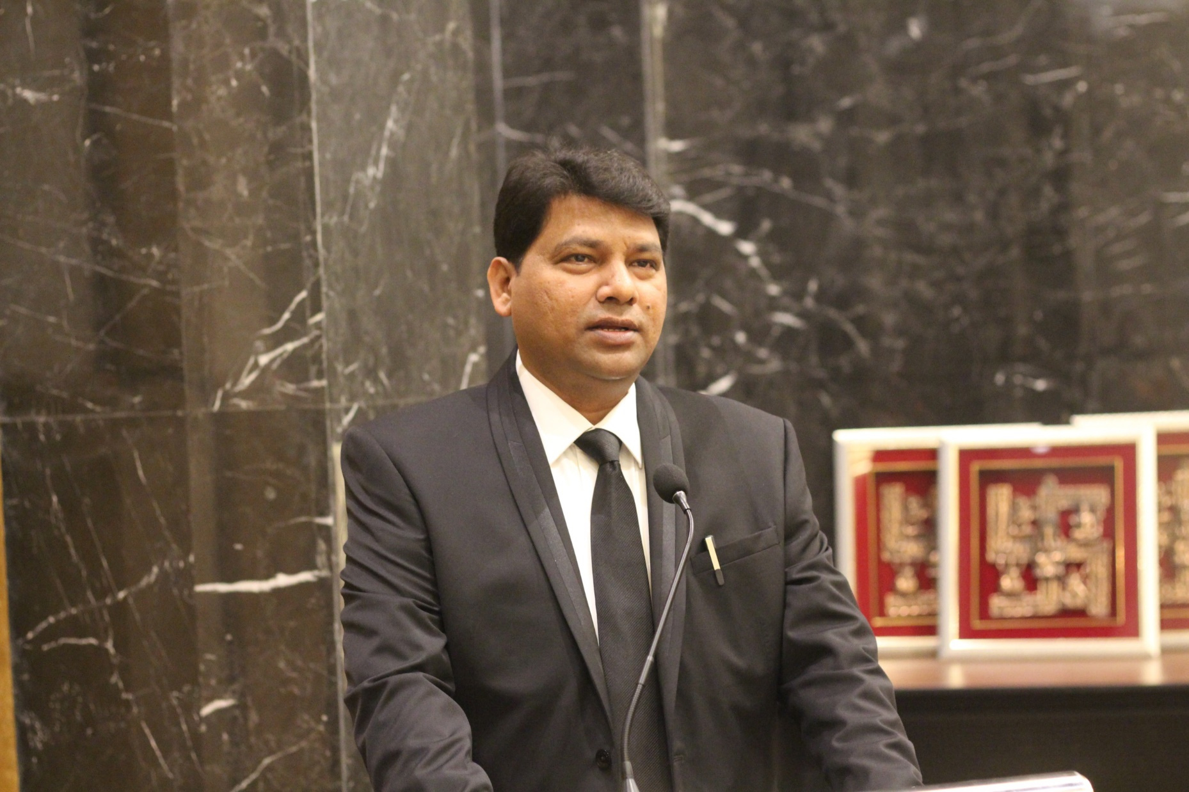
FOUNDER DIRECTOR
SOFTPRO GROUP OF COMPANIES
MD & Chairman
Softpro Group of Companies
Lucknow
MEMBER
Academic Council, IET Lucknow
Board of Technical Education, Lucknow
BOS – Dr. R L Awadh University, Ayodhya
Er. Ajay Chaudhary
B.TECH (1995) IET LUCKNOW
Ex Member – Executive Council
Dr. A P Abdul Kalam Technical University,
Lucknow

Slide 6
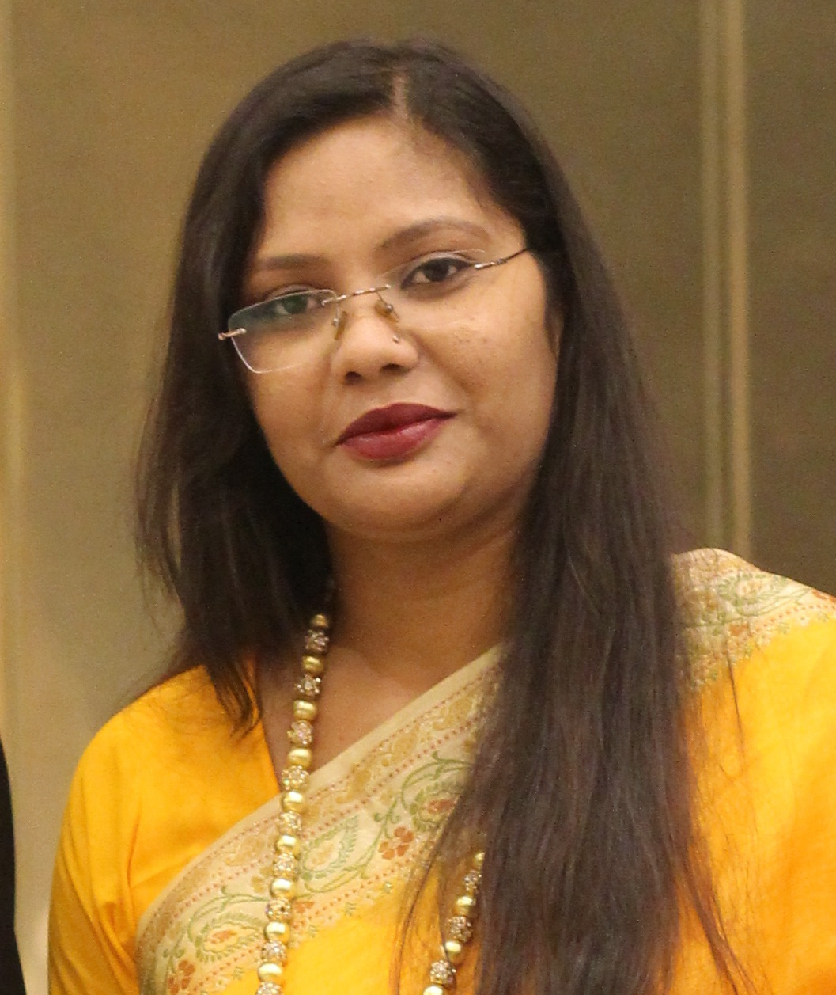
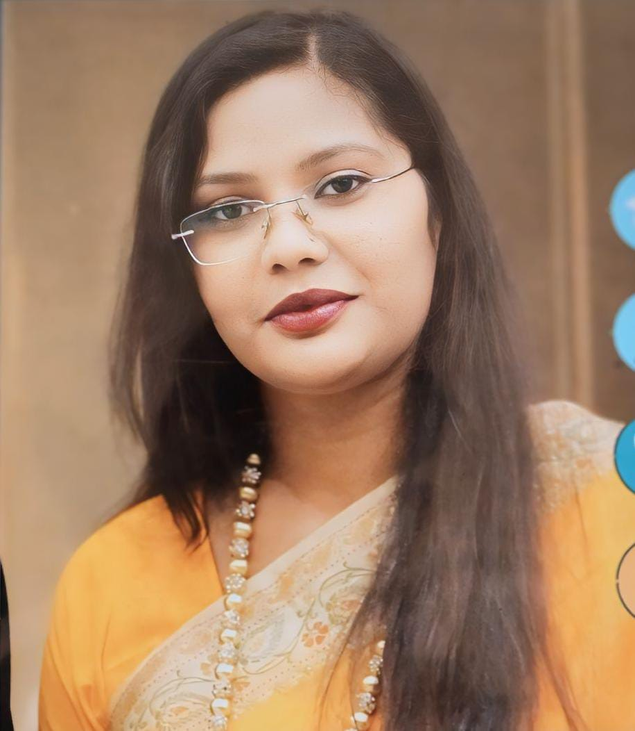
CHIEF EXECUTIVE OFFICER
SOFTPRO GROUP OF COMPANIES
Co-Founder
Parivartan ‘Ek Salah’
NGO Under CSR of Softpro group
MCA
JIWAJI UNIVERSITY, GWALIOR
Ex. Employee – Wipro Technologies
She is one of the founding members of Softpro Group. In her
working tenure of 14 years, she worked for clients of national
and international repute. She started her career working with IT Giant “Wipro Technologies, Mysore”, gradually shifting
to Lucknow and associating with Softpro Group.

Slide 7
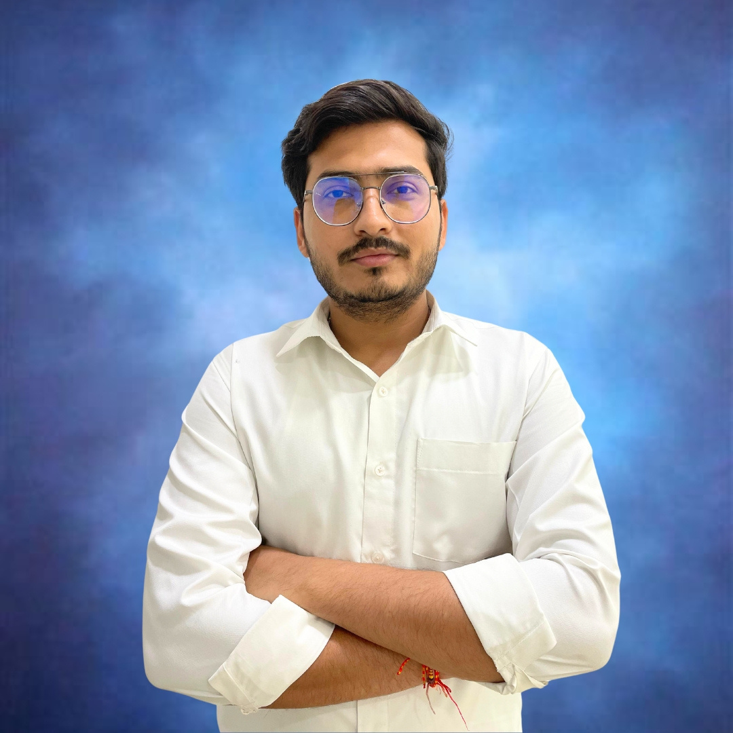
MY CONSULTANT
Name: Er. Subrat Tripathi
Designation: Senior Consultant – ML & DS
Qualification: B.Tech
Experience: 06+ Years
With over 6 years of experience in the IT industry, I have honed my skills in Python, Machine Learning, and Data Science. Throughout my career, I have successfully managed and delivered projects for prominent companies such as Meesho, LIC, MetLife, and many more. My work has spanned various domains, enabling me to develop a deep understanding of the challenges and solutions in these fields. I am passionate about leveraging data-driven insights to drive business success and am committed to continuous learning and innovation in the rapidly evolving tech landscape.

Slide 8
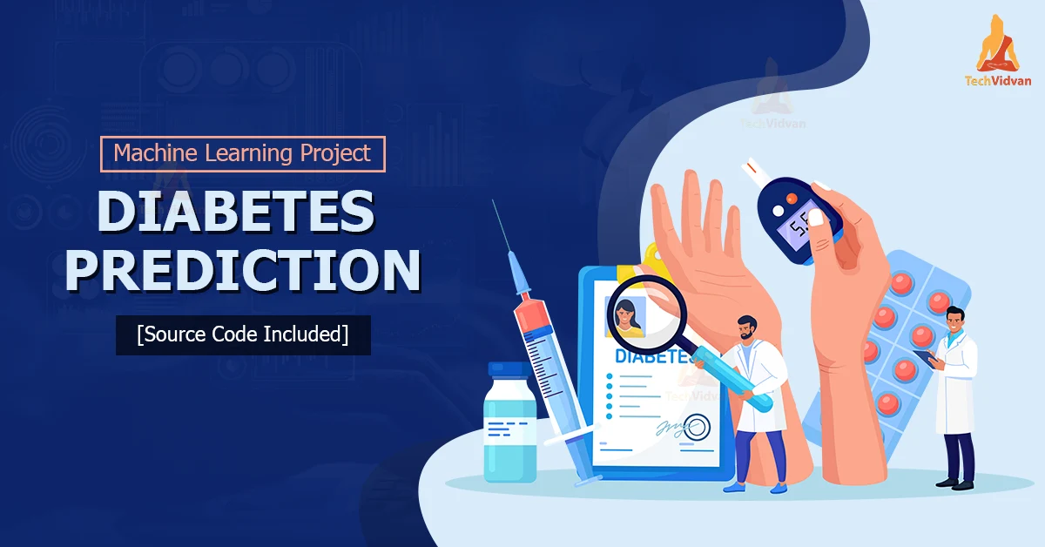
Multiple Disease Prediction system using Machine learning
(health guard)

Slide 9
Table of content
Introduction
Why we need the health guard
Technology and Library
Data Flow diagram
Screen Shot
Conclusion
Thank You

Slide 10

introduction
Multiple disease prediction is a health guard application that uses machine learning algorithms to predict the likelihood of a patient having multiple diseases.
The application analyzes a patient's medical history and symptoms to build models that can accurately predict the probability of various diseases. The goal is to identify patients at an early stage so they can receive timely treatment and improve healthcare

Slide 11

Why we need the health guard
Early Detection and Prevention
Comprehensive Health Monitoring
Personalized Healthcare
Resource Efficiency
Public Health Benefits

Slide 12


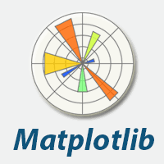






technology and library
SOFTWARE

Slide 13
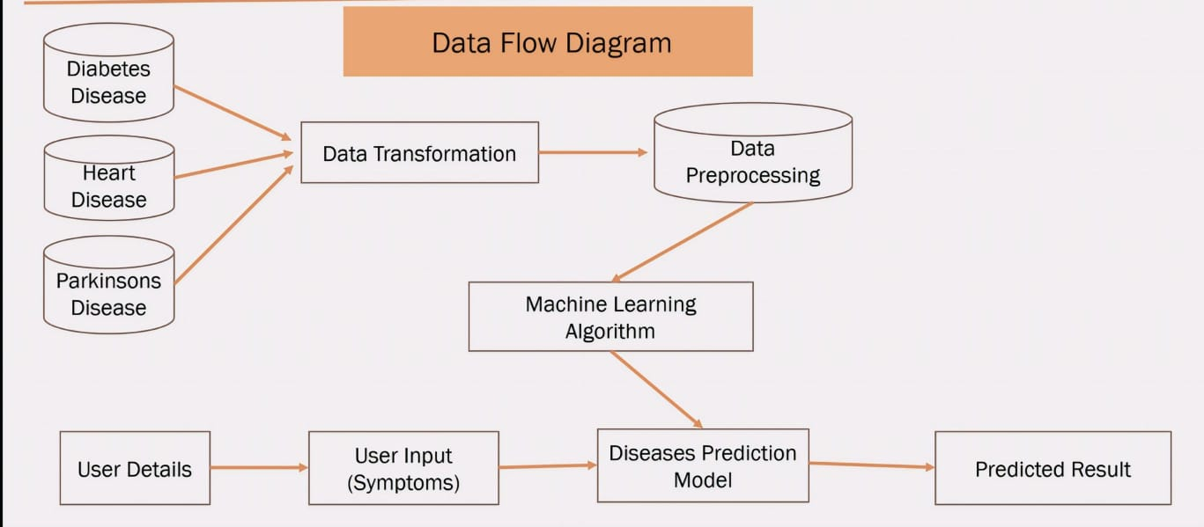
Dynamic delivery
DATA FLOW DIAGRAM
Learn to infuse energy into your delivery to leave a lasting impression
One of the goals of effective communication is to motivate your audience
Metric | Measurement | Target | Actual
Audience attendance | # of attendees | 150 | 120
Engagement duration | Minutes | 60 | 75
Q&A interaction | # of questions | 10 | 15
Positive feedback | Percentage (%) | 90 | 95
Rate of information retention | Percentage (%) | 80 | 85

Slide 14
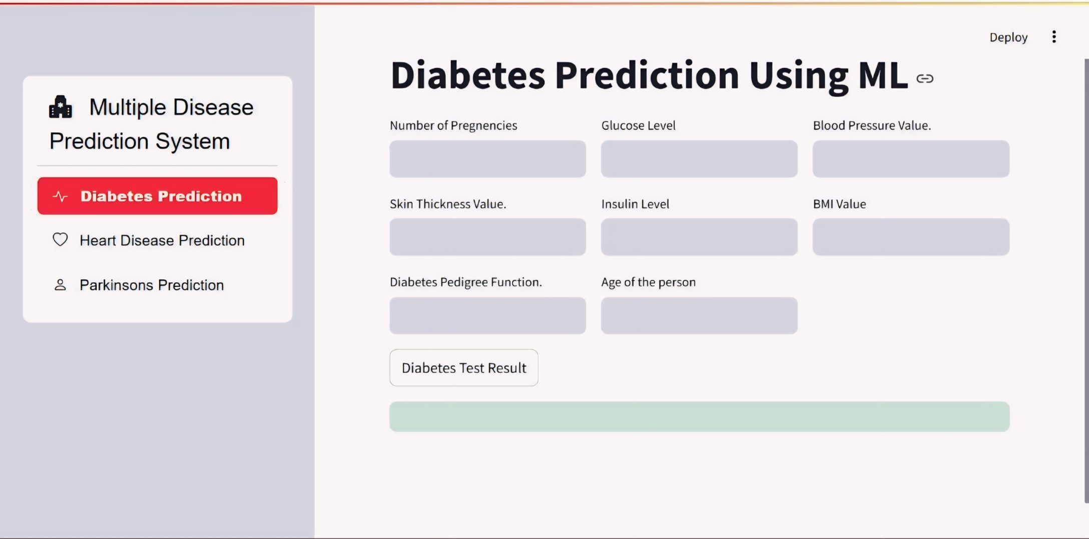
Selecting visual aids
SCREEN SHORT
Enhancing your presentation

Slide 15
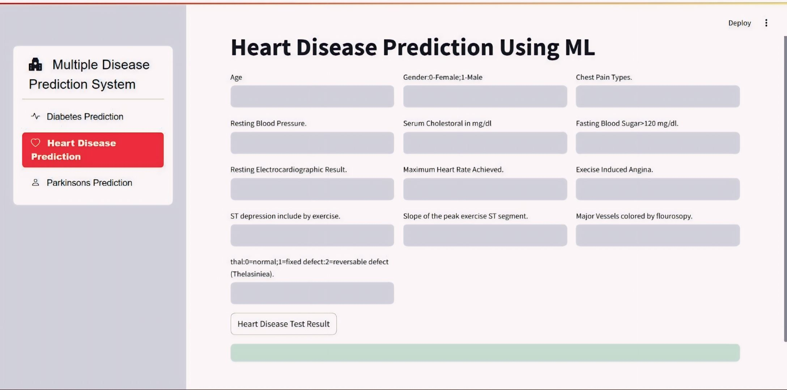
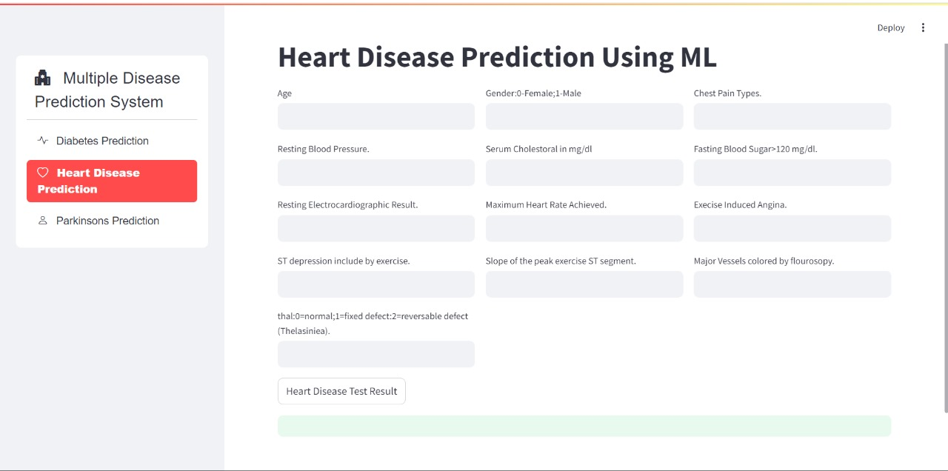
Effective delivery techniques
This is a powerful tool in public speaking. It involves varying pitch, tone, and volume to convey emotion, emphasize points, and maintain interest.
Pitch variation
Tone inflection
Volume control
Effective body language enhances your message, making it more impactful and memorable.
Meaningful eye contact
Purposeful gestures
Maintain good posture
Control your expressions

Slide 16
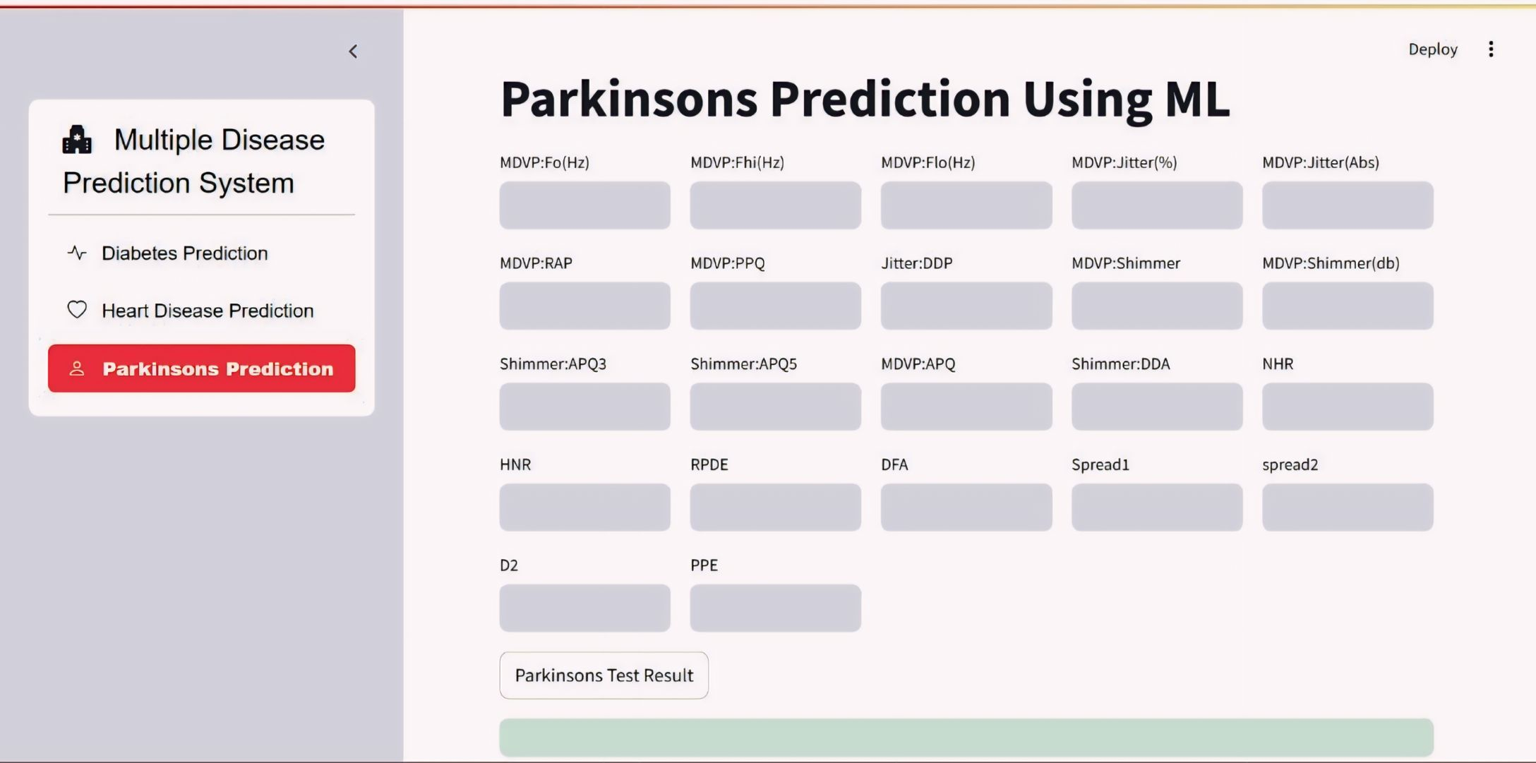
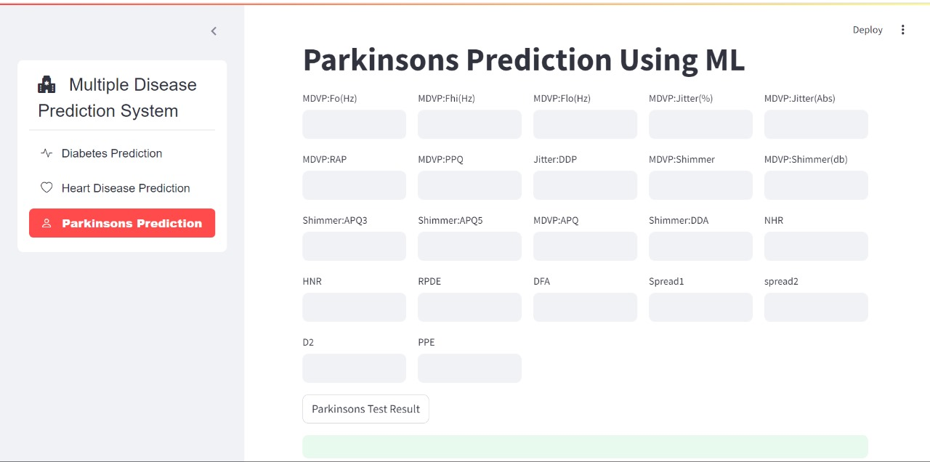
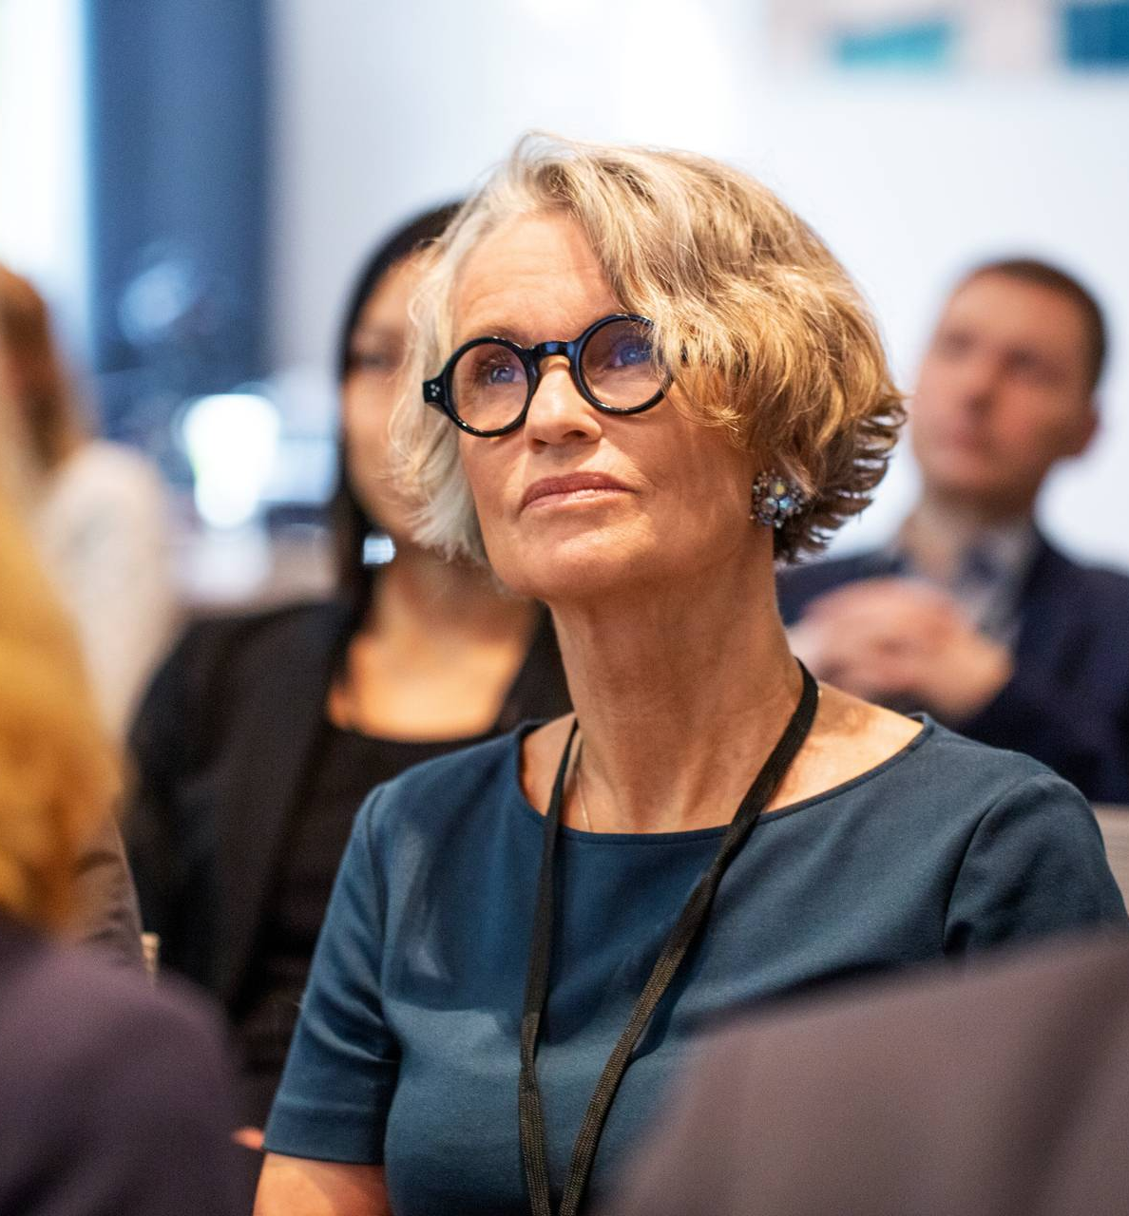
Speaking impact
Your ability to communicate effectively will leave a lasting impact on your audience
Effectively communicating involves not only delivering a message but also resonating with the experiences, values, and emotions of those listening

Slide 17
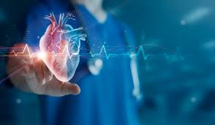
Future scope and conclusion
conclusioN
In conclusion, while a multiple diseases prediction system offers significant potential to revolutionize healthcare by enabling early diagnosis and personalized treatment, it must be continuously refined and validated to ensure it provides reliable, unbiased, and interpretable predictions.
Impact factor | Measurement | Target | Achieved
Audience interaction | Percentage (%) | 85 | 88
Knowledge retention | Percentage (%) | 75 | 80
Post-presentation surveys | Average rating | 4.2 | 4.5
Referral rate | Percentage (%) | 10 | 12
Collaboration opportunities | # of opportunities | 8 | 10

Slide 18
Thank you

